Slide 1


Introduction to
Robotic Process Automation
MULTI LANGUAGE DICTIONARY
REG NO. - 220701032
NAME - ASHWANTH E
GUIDE NAME - JINU SOPHIA
DESIGNATION - B.E COMPUTER SCIENCE AND ENGINEERING

Slide 2
Abstract
This project presents a multi-language dictionary and translation system, designed as an advanced Robotic Process Automation (RPA) solution. Leveraging the power of content generation and translation connector activities, the system provides comprehensive support for multilingual communication and learning. Through seamless integrations, the RPA workflow offers users the ability to quickly obtain dictionary definitions and translations across various languages. The project demonstrates the potential of RPA in enhancing accessibility, promoting language learning, and supporting real-time, cross-language communication. By combining automation with linguistic intelligence, this multi-language tool serves as an accessible resource, fostering improved understanding and engagement across linguistic boundaries.
Department of Computer Science and Engineering
Rajalakshmi Engineering College ‹2›
Notes:
‹#›

Slide 3
Need for the Proposed System
Increasing Demand for Multilingual Communication
Language barriers can hinder effective communication.A multi-language dictionary and translator system addresses these challenges by providing real-time language assistance.
Limited Access to Comprehensive Language Resources
By offering integrated dictionary and translation functions in one system, this RPA solution provides a convenient, high-quality language resource accessible from a single platform.
Scalability for Diverse Applications
It provides flexibility, allowing users to translate various types of text across multiple languages and adapt to diverse use cases—from document translation to educational content generation—without extensive customization.
Enhanced Learning and Accessibility
language skills, this system offers an accessible way to learn and understand new languages. The system’s dictionary component provides definitions, synonyms, and context, while the translation feature facilitates real-time language learning. This dual-function tool serves as both a resource and learning aid, promoting inclusivity and enhancing language accessibility for users worldwide.
Department of Computer Science and Engineering
Rajalakshmi Engineering College ‹3›
Notes:
‹#›

Slide 4
Advantages of the Proposed System
Efficient and Automated Language Processing
Accessibility Across Multiple Languages
Enhanced User Experience with Real-Time Responses
Consistency and Accuracy in Language Translation
Flexible Applications Across Industries and Use Cases
Enhanced Language Learning and Contextual Understanding
Consistent Availability and Reliability
Department of Computer Science and Engineering
Rajalakshmi Engineering College ‹#›
Notes:
‹#›

Slide 5
Main Objective
"The main objective of this project is to develop an advanced, multi-language dictionary and translation system that leverages Robotic Process Automation (RPA) to automate content generation and translation activities. This system aims to provide accurate and instant dictionary definitions, translations, and language learning content for users across different languages. The project intends to simplify and enhance cross-language communication by offering seamless integration with third-party APIs for real-time translations and extensive language support. By automating these processes, the system will increase accessibility, break down language barriers, and facilitate language learning in both personal and professional contexts. Additionally, it aims to ensure scalability and adaptability by supporting a wide range of languages, making it a valuable tool for global users seeking efficient language solutions."
Department of Computer Science and Engineering
Rajalakshmi Engineering College ‹#›
Notes:
‹#›

Slide 6
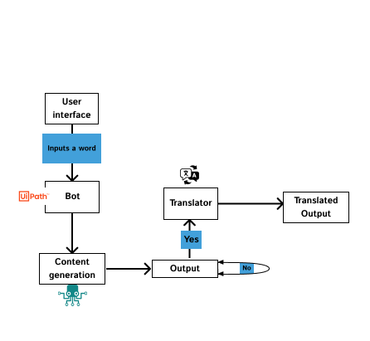
Architecture
Department of Computer Science and Engineering
Rajalakshmi Engineering College ‹#›
Notes:
‹#›

Slide 7
System Requirements
Hardware
Processor: Intel Core i5 (Min), Core i7 (Rec)
RAM: 8 GB (Min), 16 GB (Rec)
Storage: 250 GB SSD (Min), 500 GB SSD (Rec)
GPU (Optional): NVIDIA RTX 3060 or higher (for NMT)
Network: Stable broadband (10 Mbps+)
Software
OS: Windows 10/11, Ubuntu 20.04+, macOS
APIs: Google Translate API, OpenAI GPT, Microsoft Translator
Department of Computer Science and Engineering
Rajalakshmi Engineering College ‹#›
Notes:
‹#›

Slide 8
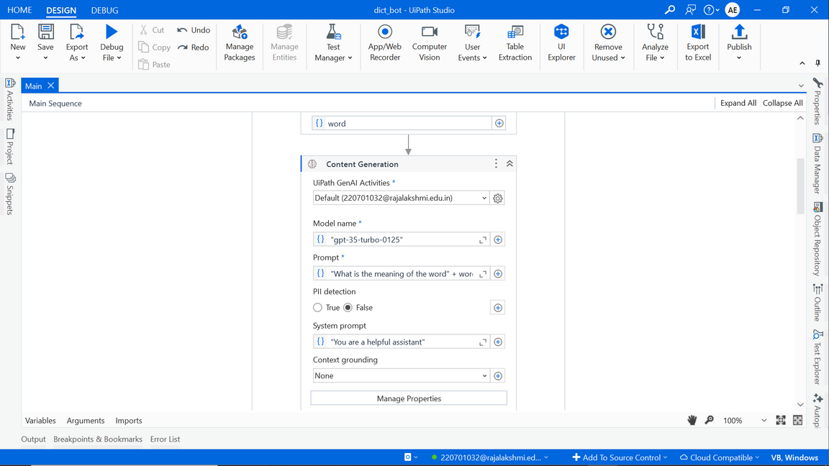
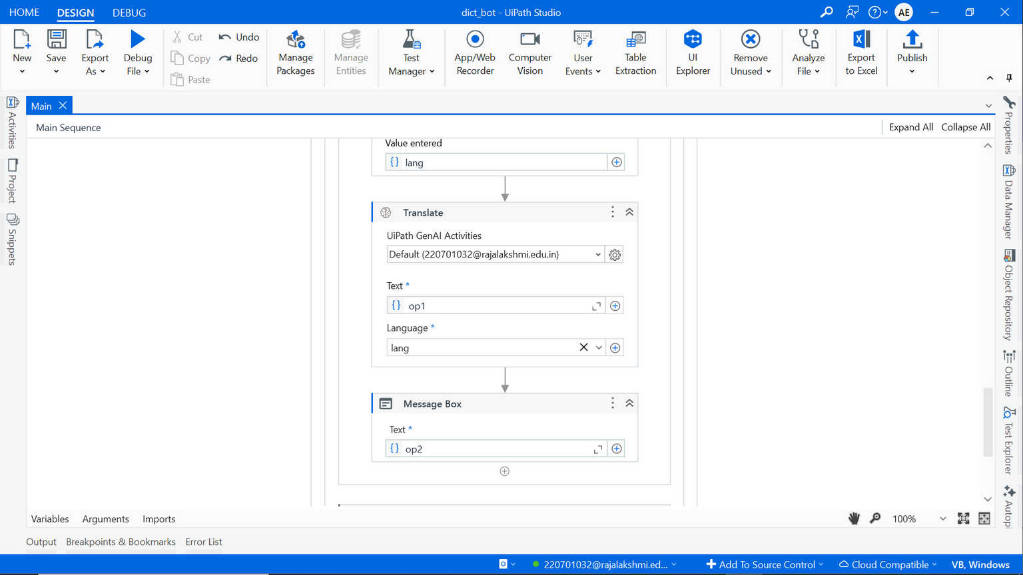
Functional Description
Name of the Module 1: Content Generation Module
The Content Generation Module is responsible for automatically generating and providing dictionary definitions, word usage examples, and additional linguistic information. It connects to external databases or API sources to fetch relevant content, enriching the user’s language learning experience.
DFD / Activity Diagram.
Name of the Module 2: Translation Module
The Translation Module provides real-time translation services, allowing users to translate words or phrases between multiple languages. It uses external APIs (e.g., Google Translate, Microsoft Translator) to perform language detection and translation, ensuring accurate and quick results.
DFD / Activity Diagram
Department of Computer Science and Engineering
Rajalakshmi Engineering College ‹#›
Notes:
‹#›

Slide 9
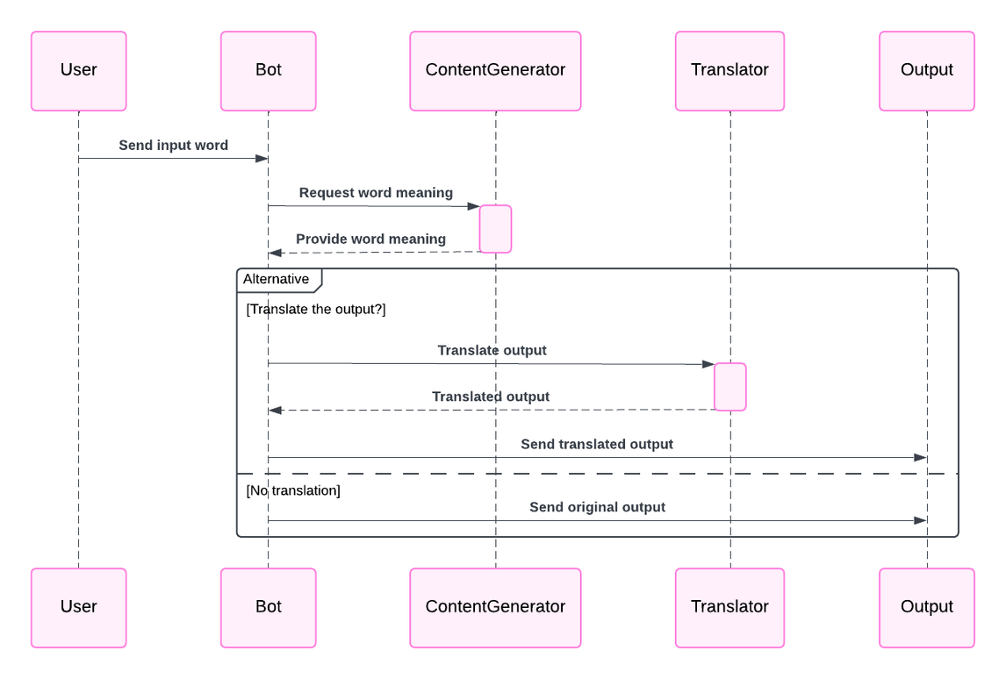
Table Design
Department of Computer Science and Engineering
Rajalakshmi Engineering College ‹#›
Notes:
‹#›

Slide 10
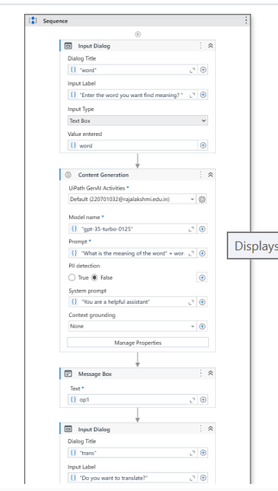
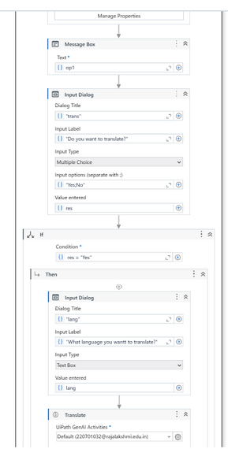
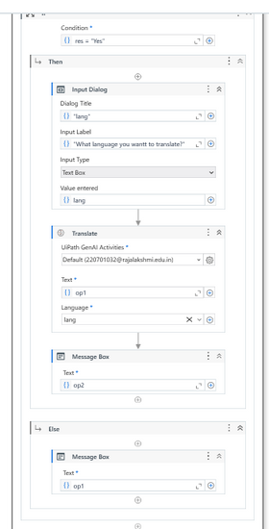
Process Design
Department of Computer Science and Engineering
Rajalakshmi Engineering College ‹#›
Notes:
‹#›

Slide 11
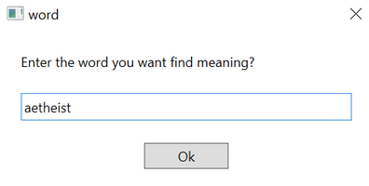
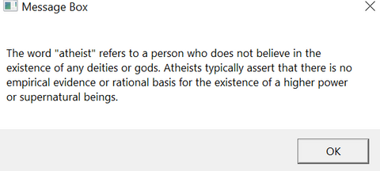
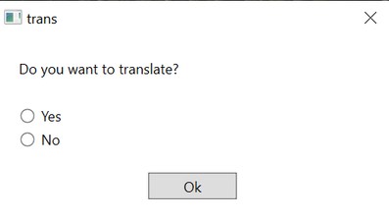
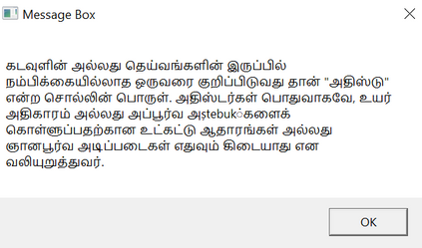
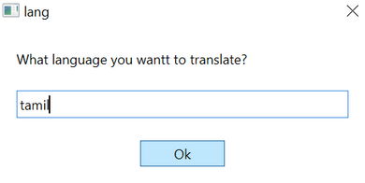
Implementation
Implementation of Module 1
Content generation
Implementation of Module 2
Translator for any language
Department of Computer Science and Engineering
Rajalakshmi Engineering College ‹#›
Notes:
‹#›

Slide 12
Conclusions
The multi-language dictionary and translator project successfully integrates Robotic Process Automation (RPA) with advanced language processing capabilities, delivering an efficient, user-friendly tool for real-time translations and language learning. By automating content generation and translation tasks, the system enhances accessibility to linguistic resources and bridges communication gaps between users of different languages. The seamless integration of third-party APIs for both dictionary content and translation ensures accurate and up-to-date results across multiple languages, making the system adaptable and scalable for global use.
Throughout the project, challenges related to handling diverse languages, real-time processing, and ensuring translation accuracy were effectively addressed, demonstrating the system’s robustness and reliability. This project highlights the potential of RPA in automating complex language tasks, offering significant improvements in efficiency, accessibility, and user experience.
Department of Computer Science and Engineering
Rajalakshmi Engineering College ‹#›
Notes:
‹#›

Slide 13
References
A Survey on Machine Translation: Techniques, Applications, and Challenges
This paper provides a thorough review of machine translation methods, which would be beneficial for understanding the technologies behind real-time translation APIs.
Exploring the Performance of Various Neural Machine Translation Models
A detailed analysis of different translation models, highlighting the state-of-the-art approaches in machine translation, which could be useful for understanding the translation mechanisms in your project.
Department of Computer Science and Engineering
Rajalakshmi Engineering College ‹#›
Notes:
‹#›

Slide 14
Future Enhancement
Speech-to-Text and Text-to-Speech Integration
Context-aware Translation
Offline Translation Capability
Optical Character Recognition (OCR) for Translation
Support for Rare Languages
Department of Computer Science and Engineering
Rajalakshmi Engineering College ‹#›
Notes:
‹#›

Slide 15
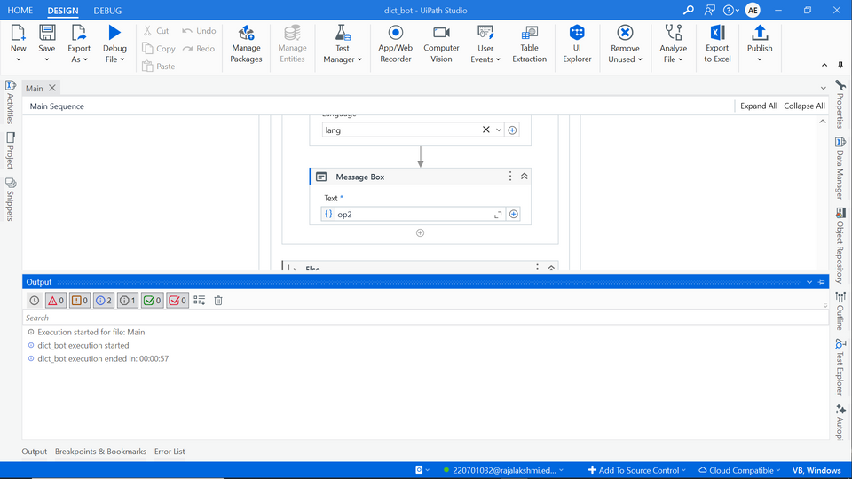
Testing
Department of Computer Science and Engineering
Rajalakshmi Engineering College ‹#›
Notes:
‹#›

Slide 16
IEEE Paper
Title
Authors
Department of Computer Science and Engineering
Rajalakshmi Engineering College ‹#›
Notes:
‹#›

Slide 17
Literature Survey
1.Microsoft Translator Activities in UiPath
This tool integrates the Microsoft Translator API into UiPath Studio, enabling capabilities such as:
Language Detection: Identifies the language of text input.
Text Translation: Translates text between over 100 languages.
Transliteration: Converts text from one script to another (e.g., Hanyu to Pinyin).
Advantages:
Seamless integration into UiPath workflows for automation.
Supports real-time and batch translations, ideal for large-scale operations.
AI-driven translations enhance accuracy through neural machine translation.
Flexibility with multi-script text processing.
Disadvantages:
Dependence on external API keys for extensive use (Azure subscription required).
Performance depends on internet connectivity and API limits.
This tool is particularly effective for automation workflows requiring multilingual text processing in real time or document translation
2.TRAvis: Document and Text Translator for UiPath
TRAvis offers capabilities to translate documents and plain text within UiPath, supporting various file formats such as Office documents, HTML, PDFs, and subtitles. It uses Azure Cognitive Services for machine learning-based translation.
Advantages:
Handles multiple file types for translation in a single workflow.
Offers free development API keys, making it suitable for small-scale applications.
Efficient for document-heavy use cases, enhancing digital transformation.
Disadvantages:
Limited to 60+ languages compared to other tools offering over 100 languages.
Requires Azure subscription for large-scale or long-term use.
TRAvis is suited for businesses that need to translate complex document structures alongside plain text automation
Department of Computer Science and Engineering
Rajalakshmi Engineering College ‹#›
Notes:
‹#›

Slide 18
Queries
Notes:
‹#›

Slide 19
Demonstration
Notes:
‹#›

Slide 20
Thank You
Notes:
‹#›

